Slide 1
Battle of Neighborhoods
New York
- Yash Somani

Slide 2
Problem Statement
To recommend the best neighborhood to live, to buy a house, to rent an apartment or build a restaurant etc. in New York .
To understand the similarities and differences between the neighborhoods using Unsupervised K-Mean Clustering Algorithm.

Slide 3
Objective
Collecting the top trending venues in the using Foursquare API(Beautiful Soup, http request)
Forming neighborhood clusters based on venue categories using unsupervised k-mean clustering algorithm(sklearn)
Identifying and understanding the similarities and differences between two chosen neighborhoods to retrieve more insights and to conclude which neighborhood wins over other.

Slide 4
Python packages and Dependencies:
Pandas - Library for Data Analysis
NumPy – Library to handle data in a vectorized manner
JSON – Library to handle JSON files
Requests – Library to handle http requests
Matplotlib – Python Plotting Module
Sklearn – Python machine learning Library
Folium – Map rendering Library

Slide 5
Work flow
Web Scraping and Data Wrangling
Top Trending Places Extraction and Clustering

Slide 6
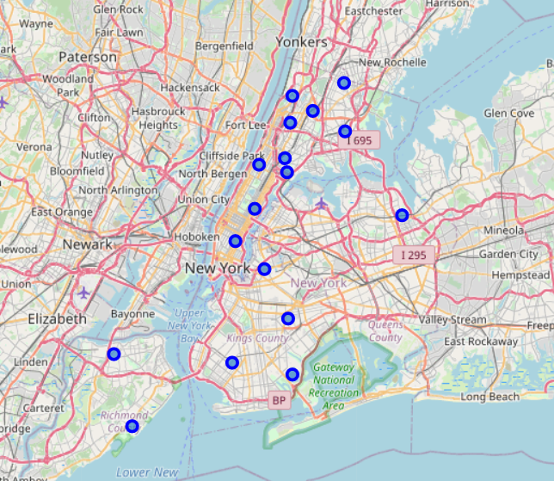
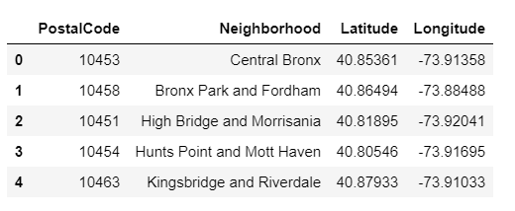
Web scraping and map rendering

Slide 7
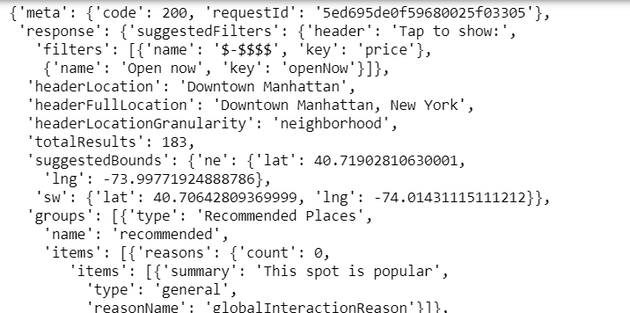
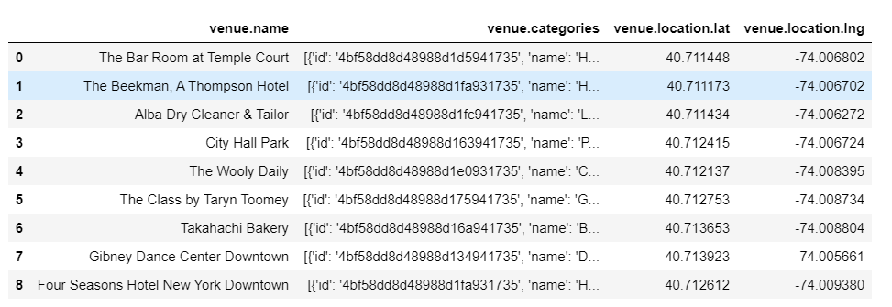
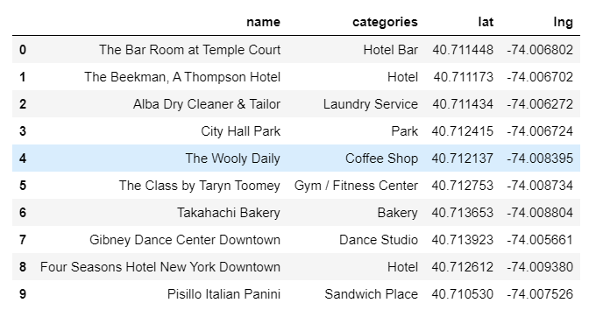
Four Square Api to retrieve hot spots nearby

Slide 8
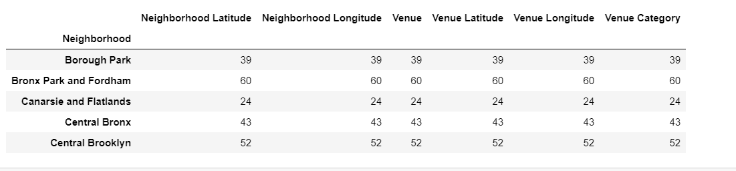
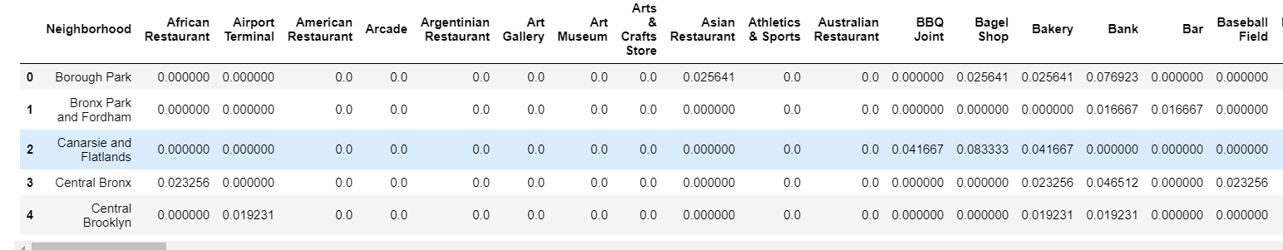
Categorizing venue

Slide 9
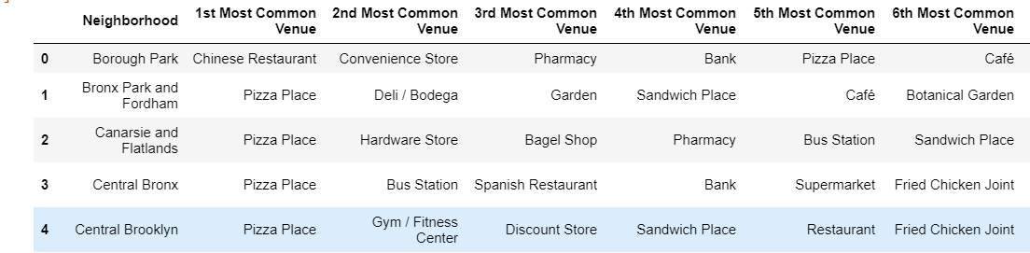
Result of TOP venues neighborhood-wise

Slide 10
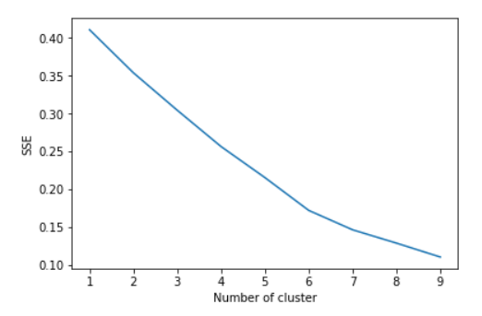
Elbow Criterion Method
Elbow method is to run k-means clustering on a given dataset for a range of values of k and for each value of k and calculate sum of squared errors (SSE).

Slide 11
sklearn.metrics.silhouette_s core
The Silhouette Coefficient is calculated using the mean intra-cluster distance (a) and the mean nearest-cluster distance (b) for each sample.
The formula for the Silhouette Coefficient of a sample is (b - a) / max(a, b).
The best value is 1 and the worst value is -1. Values near 0 indicate overlapping clusters. Negative values generally indicate that a sample has been assigned to the wrong cluster.

Slide 12
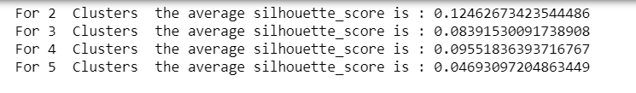
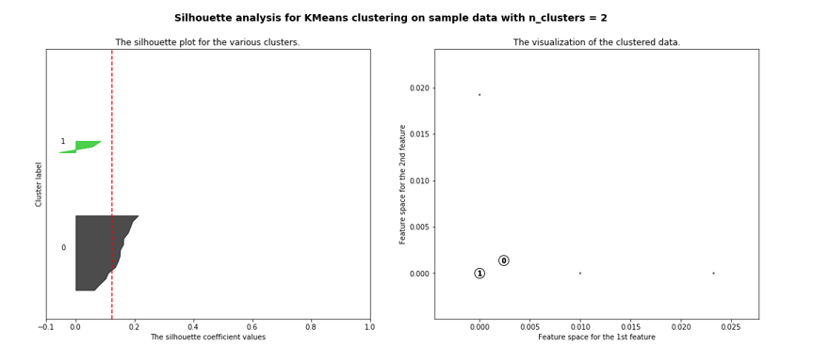
Silhouette Score and Cluster Visualizations

Slide 13
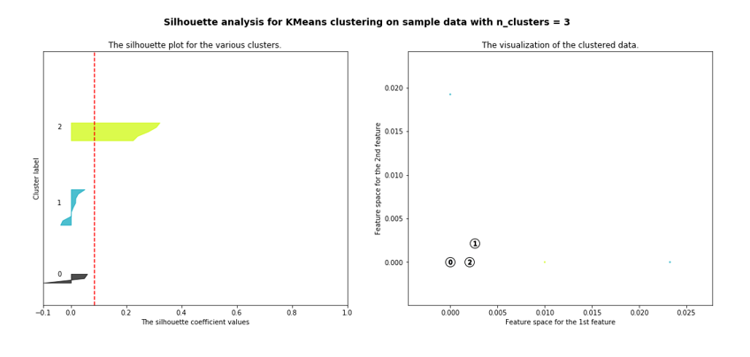
Siluhouette Score and Cluster Visualizations

Slide 14
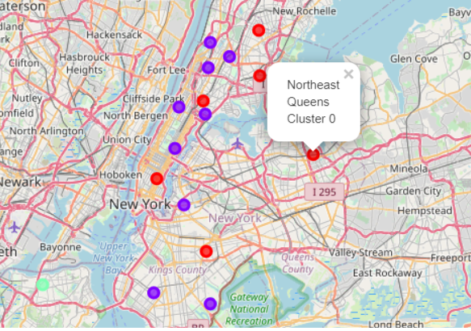
Cluster Map

Slide 15
Conclusion
The project recommends neighborhoods for families based on their needs.
Shows on Map all kinds of areas around a given neighborhood.
The Analysis shows the top venues near by each neighborhood helping in choosing the best area to move to.

